Slide 1
Car Verification
PrinceWill Okorie and Peter Rhodes

Slide 2
INTRO
Car verification is the process of predicting if two cars are of the same make and model
Replicating a portion of A Large-Scale Car Dataset for Fine-Grained Categorization and Verification by Yang et. al
Approach is to utilize a CNN as a feature extractor then make the prediction using SVM and Softmax
Insert picture from our code of

Slide 3
Data
CompCars is 208,826 images of 1716 car models collected from the web and surveillance cameras (only 78,126 images used)
Data Set | Image Count | Model Count
Train | 4,454 | 111
Train-Pairs (paper) | 100,000 | 111
Train-Pairs (us) | 208,000 | 111
Test | 22,236 | 1145
Test-Pairs | 60,000 | 1145
Notes:
Can discuss how pairs were created
Discuss that the test data was split into easy, medium and hard (add pictures)

Slide 4
Results
Model | Training Size | Val Size | P2 Test Size | P3 Test Size | Train Acc. | Val Acc. | P2 Test Acc. | P3 Test Acc.
SVM | 3563 | 891 | NA | NA | 88.54 | 86.10 | NA | ~50
SVM | 152807 | 38202 | 21224 | 20000 | 65.50 | 65.65 | 65.10 | 47.88
Softmax | 3563 | 891 | NA | NA | 89.66 | 89.24 | NA | ~50
Softmax | 152807 | 38202 | 21224 | 20000 | 65.11 | 65.45 | 64.78 | 47.66
Notes:
Current Challenges:
-had to make pairs ourselves
-a lot of trouble getting the learning to transfer to the test set (did great at training and validation), don’t understand what is different about the distributions between training and testing and the paper didn’t give us hints
-using handwritten SVM and Softmax so couldn’t easily implement things like Adam (we did try but weren’t seeing an improvement in accuracy)
-wasn’t clear what data the paper was using or how they made pairs

Slide 5
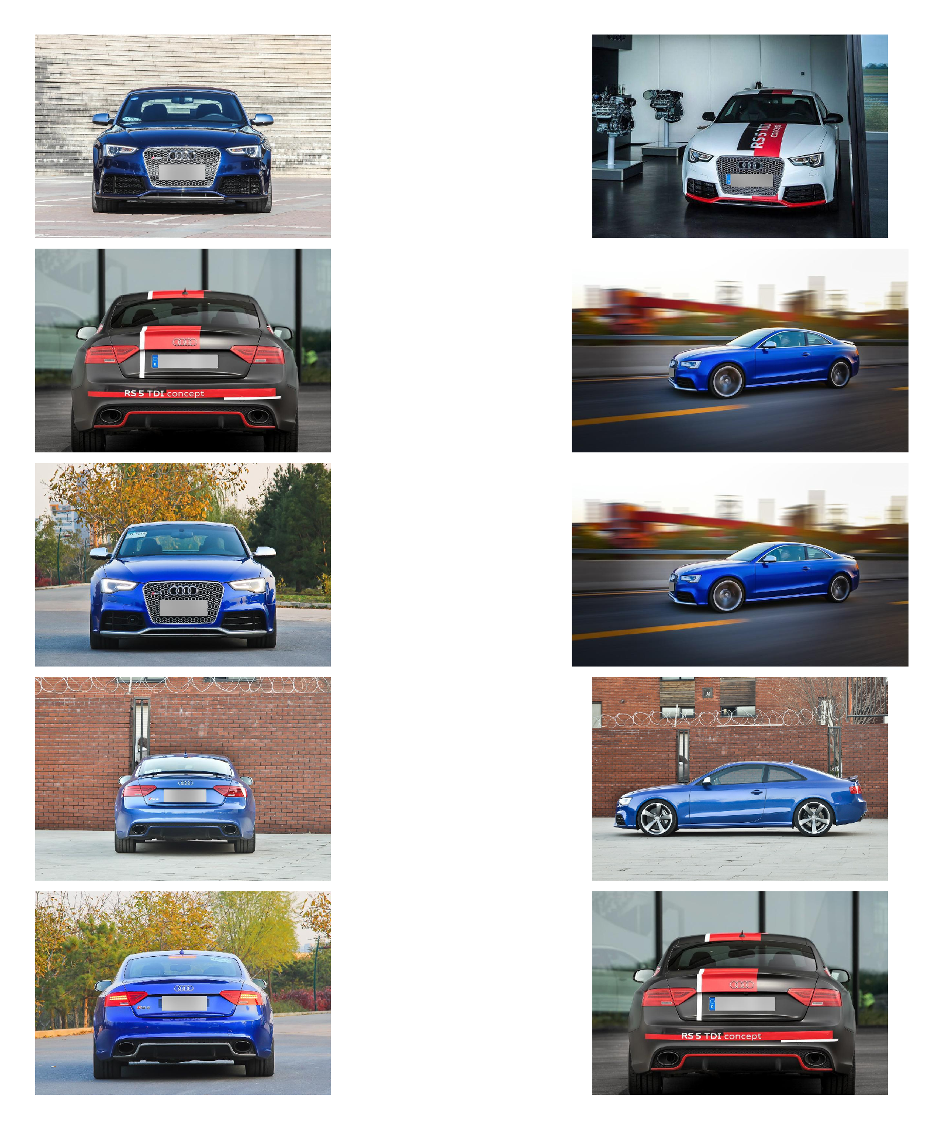
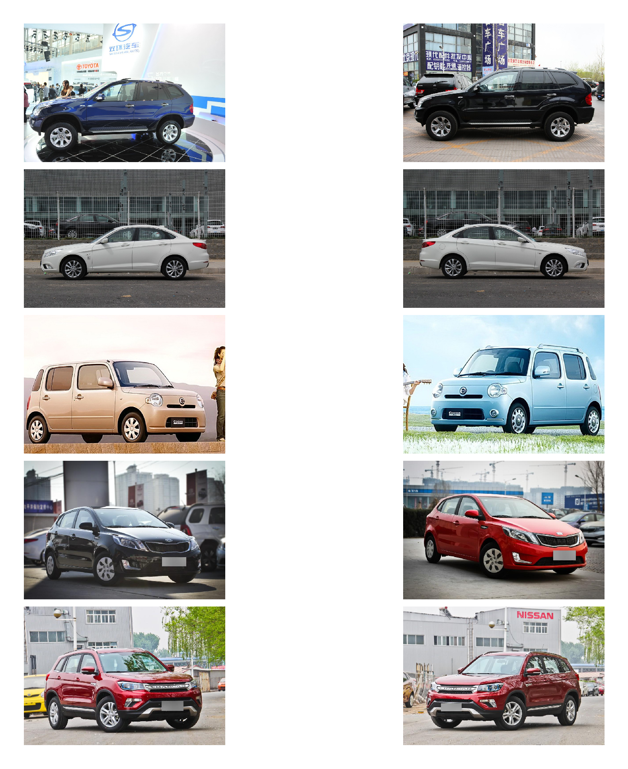
Verifications our model got right
Part II
Part III

Slide 6
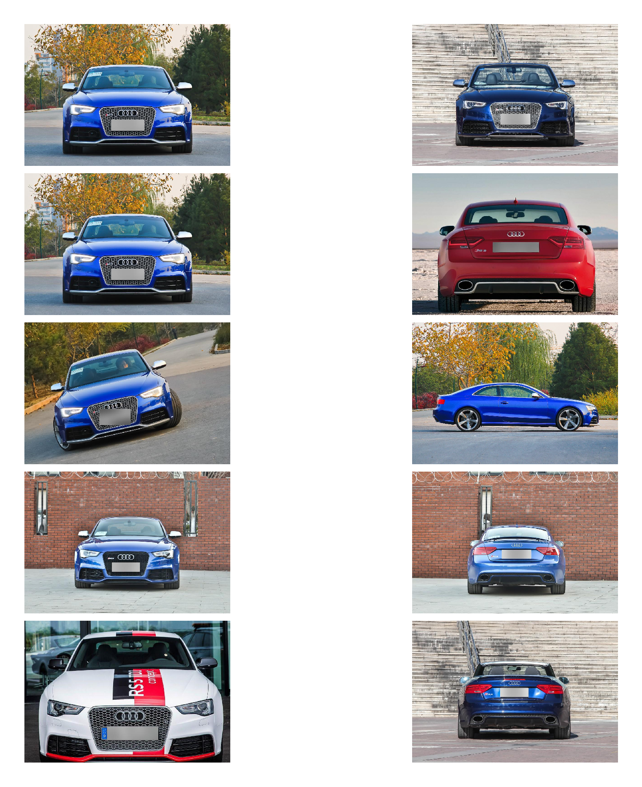
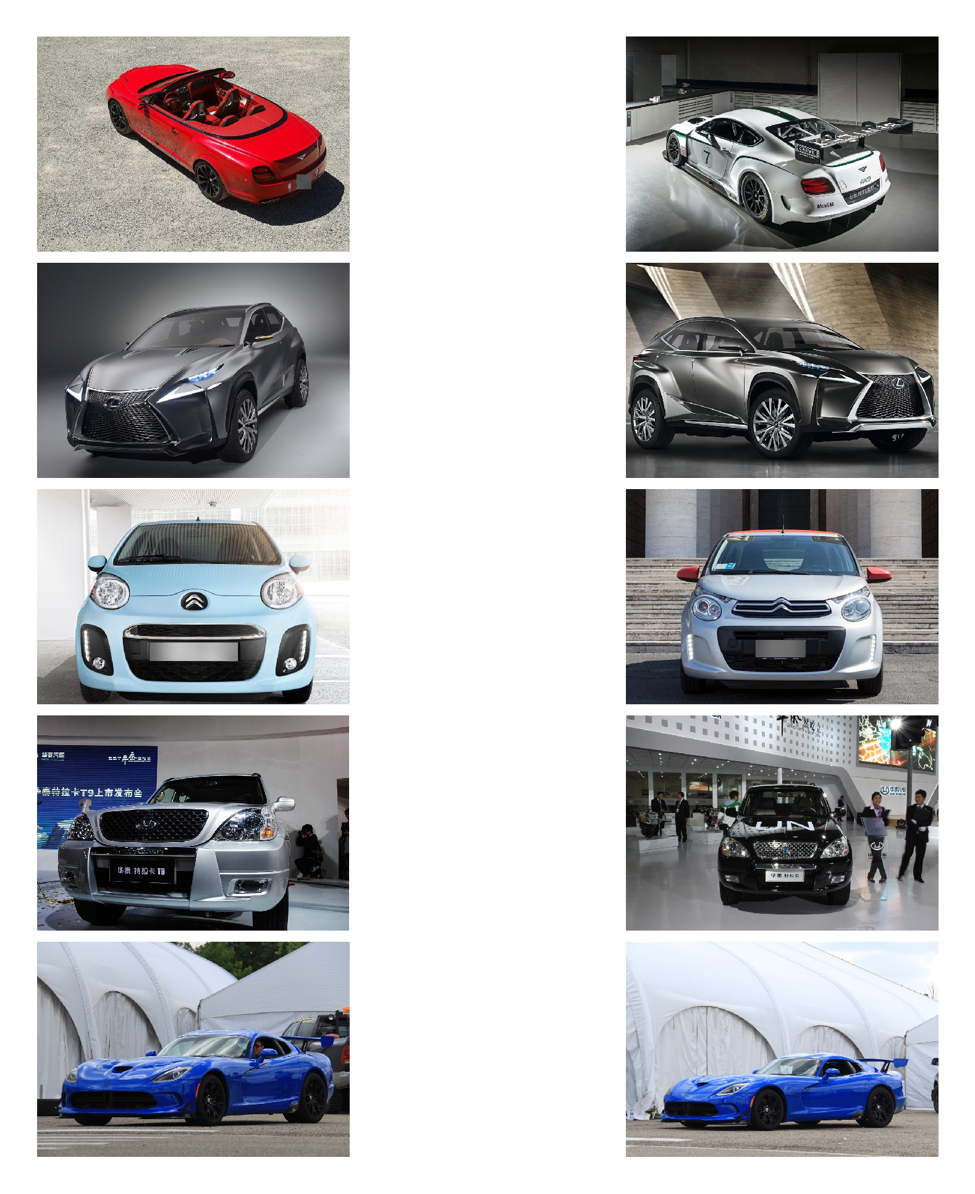
Verifications our model got wrong
Part II
Part III

Slide 7
Conclusions
Our models appear to have done better than the verification accuracy would have led us to believe
It can be very difficult to accurately predict test data (1145 car models) that is from a different distribution than the training data (111 car models)
Feature extraction works well, but make sure that you significantly limit the number of features unless you have no time constraints

